Slide 1
Mystic Bit
Learning While Drilling

Slide 2

Hello!
Who are Team Mystic Bit?
A mix of petrotechnical and data science skills
Geoscientists, RE’s, WebDev and DataSci
E&P Backgrounds
Primarily a fresh team
No pre-existing IP in project domain
Pair-programming, 3 sub-teams

Slide 3
The Challenge
Real-time, near-bit prediction 1-40m ahead of the drill-bit (18 well dataset).
Delivering value through:
Improved drilling safety
Faster decision making
Improved well targeting
Leveraging existing field observations

Slide 4

Live
Demo

Slide 5

Results
Gradient Boosting Regressor successfully trained on well data
Feature engineering: lagged OH logs
Quartile loss used to capture uncertainty
30+ separate models trained!
Python module created to deploy ML framework
Web app created with Flask, Plotly and Dash

Slide 6
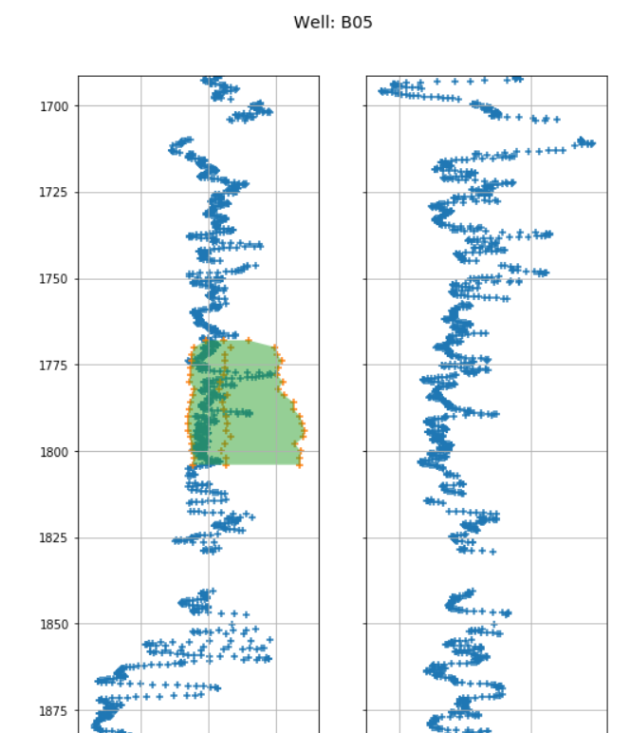
Real-time, near-bit prediction 1-40m ahead of the drill-bit (dataset of 18 wells).
P10, P50, P90 bands of uncertainty!

Slide 7
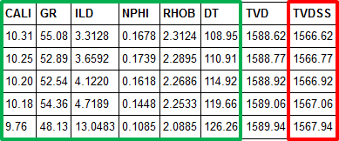
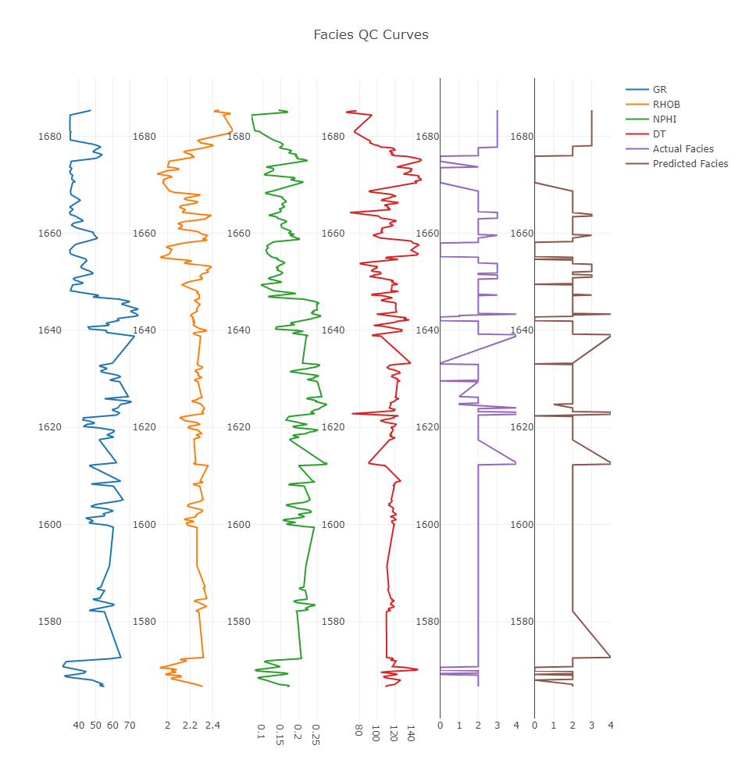
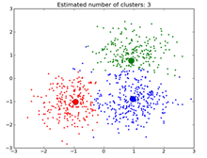
Functionality 2: Drilling a New Well (Driven Drilling Decision in Real Time
Facies classifier : Updating real-time of the geological FACIES
Used of Random Forest Classificator (100 trees). Leave One Well Out : Activated
-Tested at 95% accuracy on G+B fields w/ 4 logs (lowest 90%)
-Tested at 85% accuracy on G+B fields w/ 3 logs, (lowest X)
- RHOB removed, for cost/HSE reasons

Slide 8
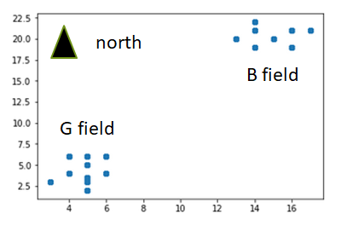
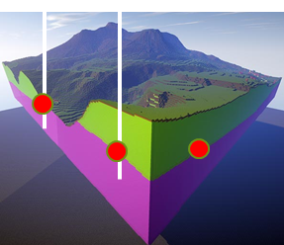
Functionality 1: Preparing a New Well (Prognosis / Well Proposal)
Mapping classifier : Geological ZONES predictor based on surrounding wells (XYZ)
- Used of Logistic Regression . Leave One Well Out : Activated
- Tested at 91% on G field (well with lowest prediction 60% > related to geological fault)

Slide 9
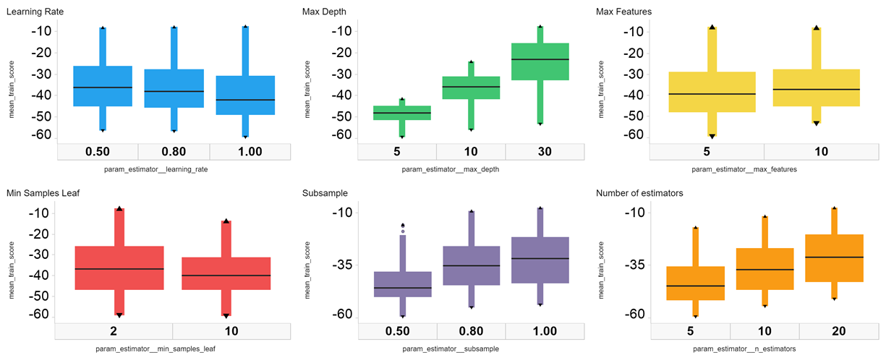
GBR HyperParameter Search
Completed a grid search across six hyperparameters:
Better Model Scores

Slide 10
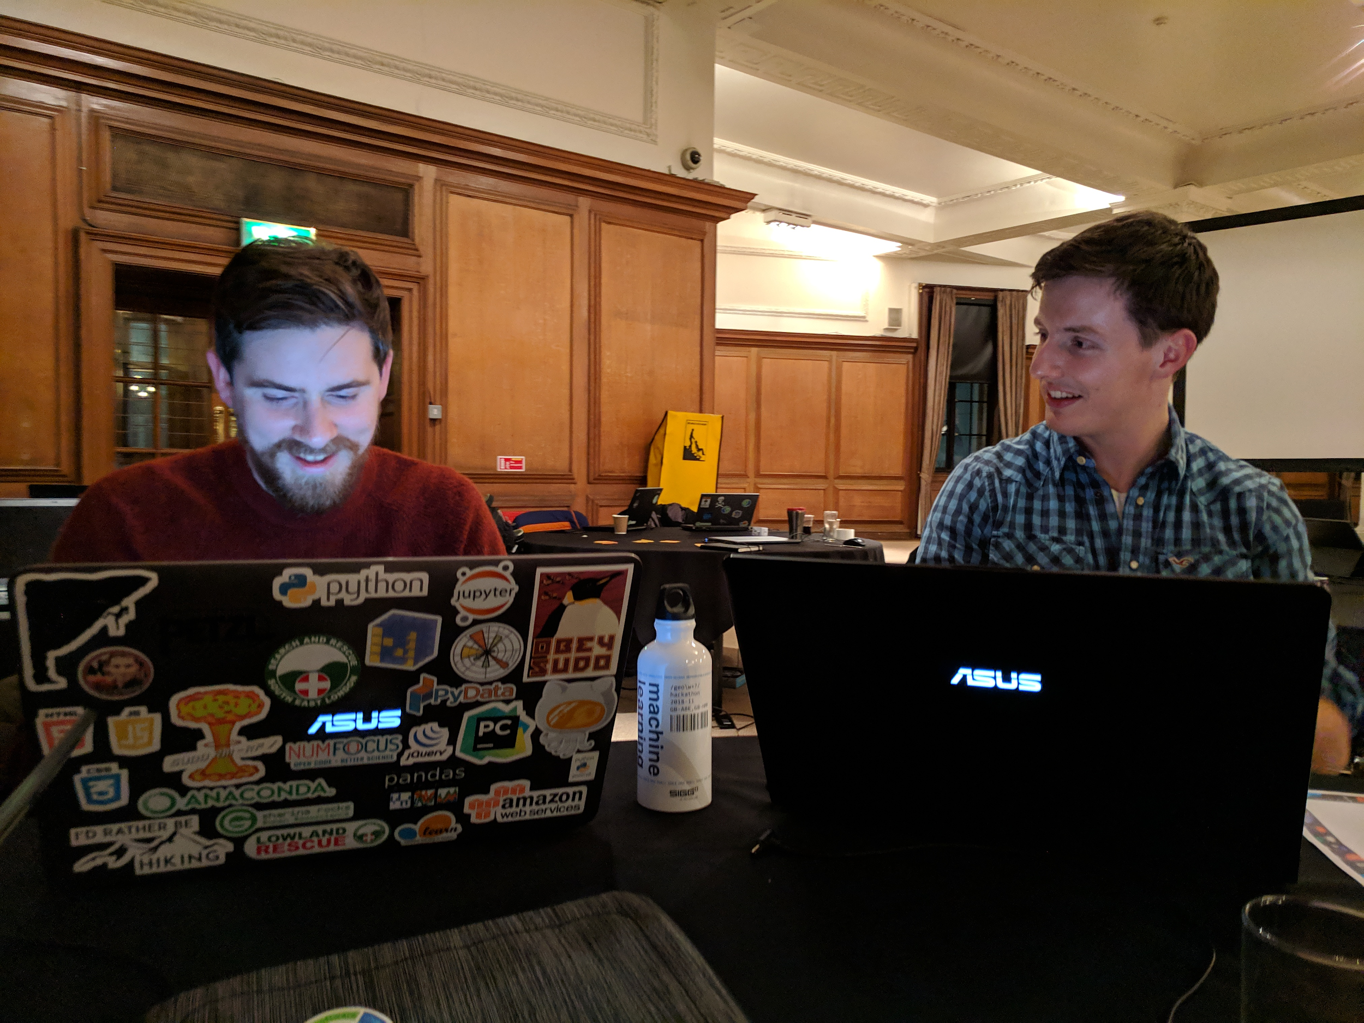
Thanks!
ANY QUESTIONS?

